Slide 1
Data Analysis Job
Which job in Data Science should one target and what skills must you have

Slide 2
Today’s Agenda
Project recap
Problem
The Analytics team
Process
Insights
Summary

Slide 3
Project Recap
In this project, I analyzed a comprehensive dataset containing job requirements across multiple data-related roles, including Data Analyst, Data Scientist, Data Engineer, BI Analyst, Machine Learning Engineer, and other emerging data careers. The goal was to understand skill demands, platforms you should always keep on check for employment, salary and the relationship between technical competencies and job categories

Slide 4
Problem
The job requirement dataset was unstructured, containing different data types and formats of skills, tools, and job descriptions.
The problem was to clean, standardize, and analyze the dataset to extract meaningful insights about job categories, required skills, and hiring trends.

Slide 5
The Analytics Team
Luke Barousse – Senior Principal Data Analysis
Moses Macharia – Data Analyst

Slide 6
Process
Data Understanding
Data Cleaning
Data Modelling
Data Analysis

Slide 7
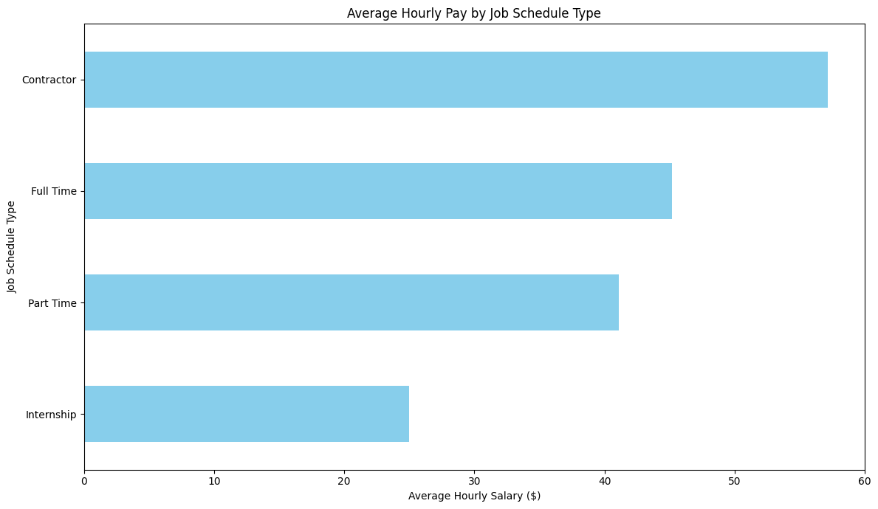
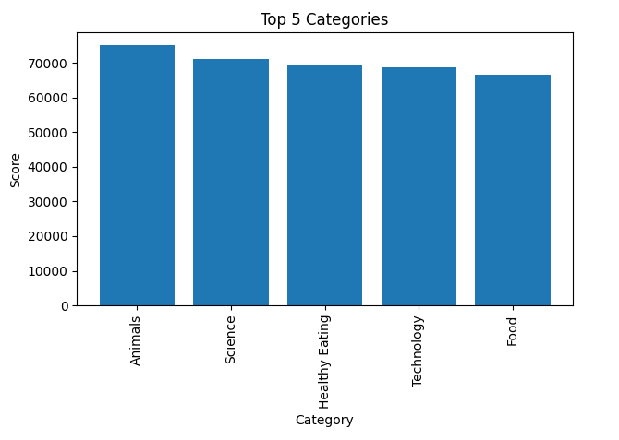
INSIGHTS: Top 5 Categories

Slide 8
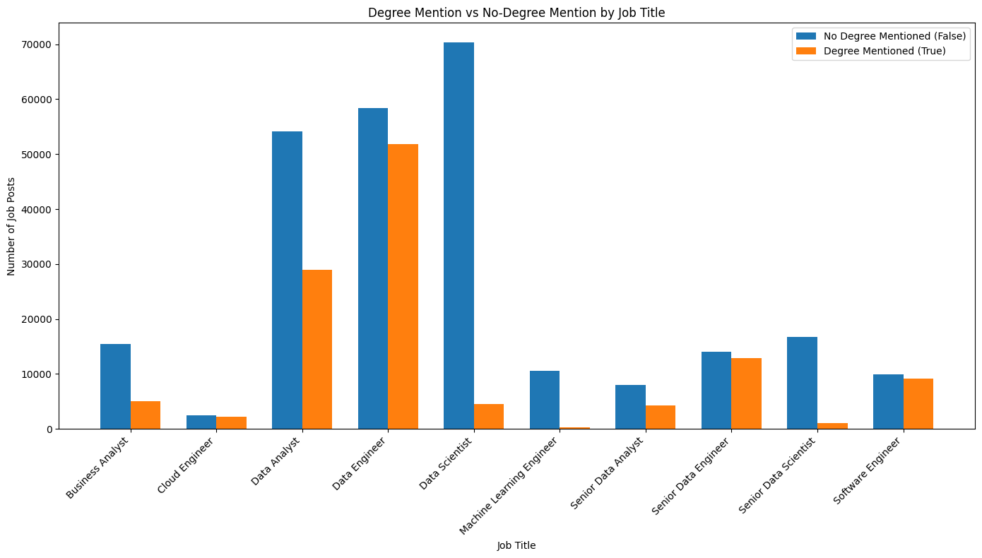
How many unique categories are there?
There are 16 categories
Studying
Healthy Eating
Technology
Food
Cooking
Dogs
Soccer
Public Speaking
Science
Tennis
Travel
Fitness
Education
Veganism
Animals
Culture

Slide 9
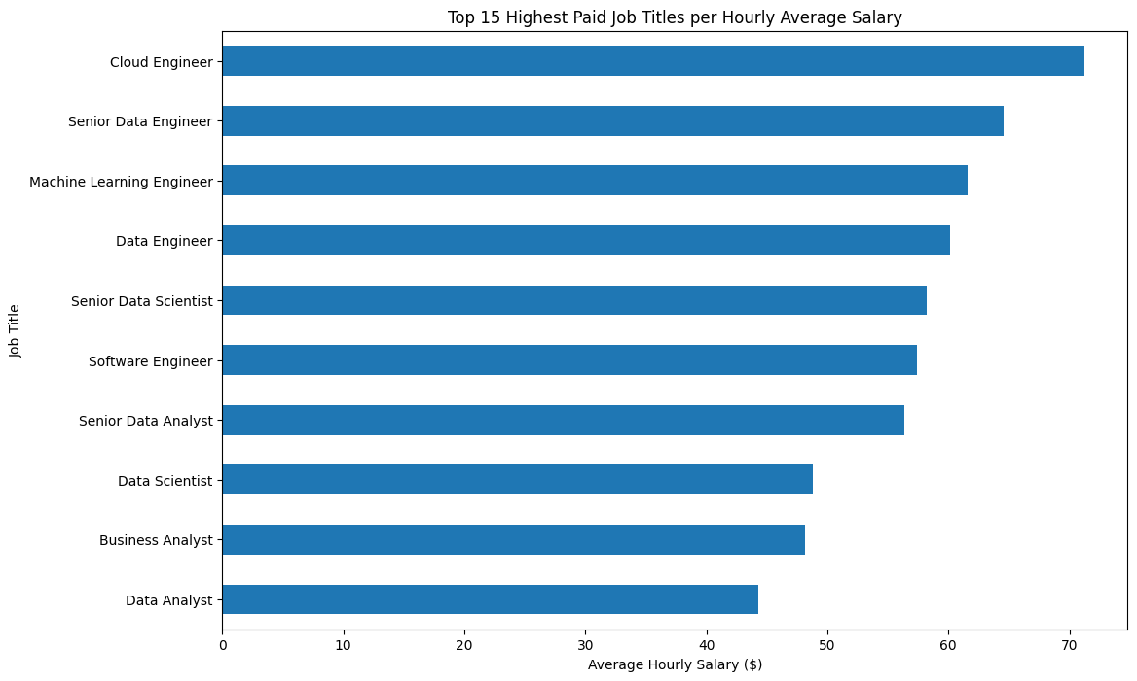
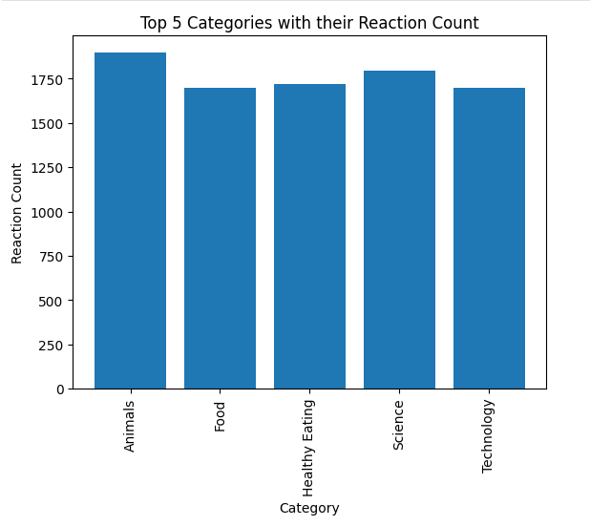
INSIGHTS: Top 5 Content Categories with their Reaction Count

Slide 10
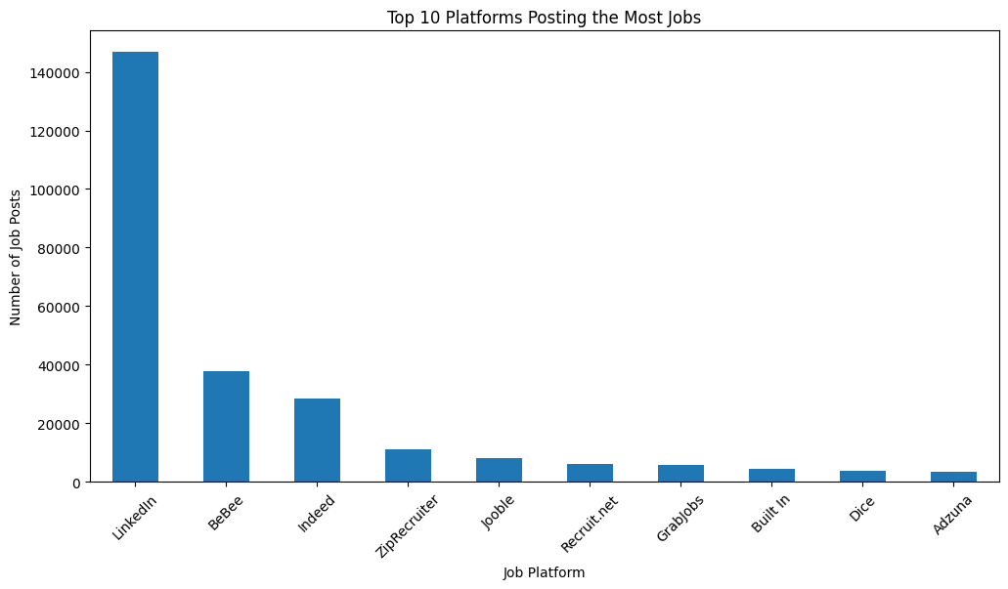
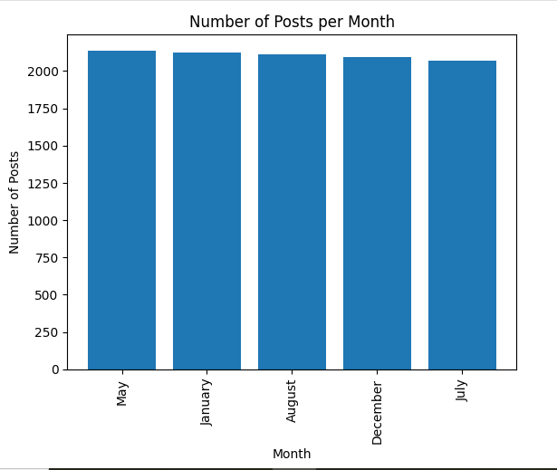
What was the month with the most posts?
The month with the most posts is the month of May.

Slide 11
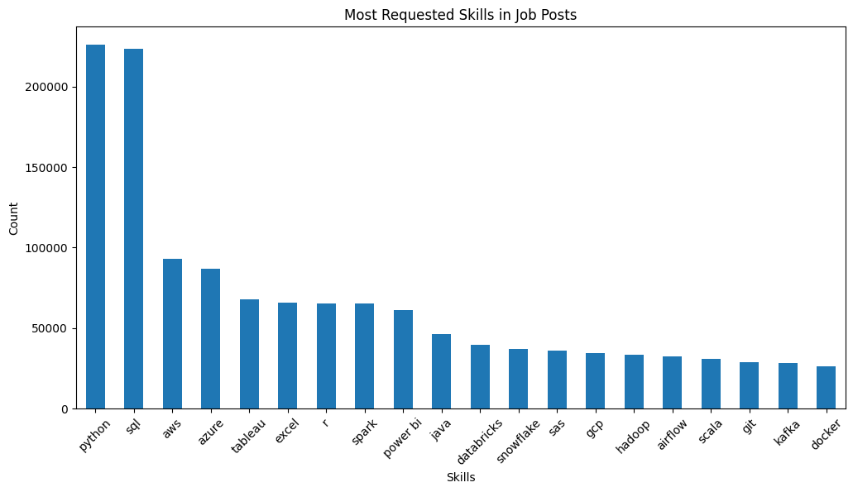

Slide 12
Discussion
The analysis of the job-postings dataset reveals several essential insights into the current landscape of data-related roles. First, contract positions consistently offer higher pay ranges than full-time or part-time roles. This aligns with broader industry patterns, where contract roles often compensate for the lack of long-term job security and benefits by offering higher hourly or project-based rates. For job seekers looking to maximize short-term earnings or individuals comfortable with flexible work arrangements, contract roles present a strong opportunity.
Another noteworthy finding is that most job postings do not specify a formal degree requirement, regardless of job type. This reflects a growing trend across the technology and data sectors, where employers increasingly prioritize hands-on experience, practical skills, and portfolio projects over traditional qualifications. The shift suggests that individuals without formal data analytics education can still access high-value roles if they demonstrate competence through real-world projects, certifications, or strong technical proficiency.

Slide 13
The dataset also shows that LinkedIn is the dominant platform for job postings, far surpassing other sources. This emphasizes LinkedIn’s importance as a central hub for both job discovery and professional visibility. For job seekers, maintaining an optimized and active LinkedIn profile is essential, as it increases exposure to recruiters and aligns with where employers are posting the majority of opportunities.
In terms of required skills, Python, SQL, and Excel emerge as the most frequently requested across all job categories. These three tools form the core technical stack for modern data work. Python supports automation, machine learning, and scripting; SQL remains fundamental for database querying; and Excel continues to be widely used for exploratory analysis, business reporting, and rapid prototyping. Their dominance highlights that employers expect candidates to be versatile in both programming and traditional analytical tools.

Slide 14
Conclusion
Overall, the findings indicate a job market that highly values skills, flexibility, and visibility. Contract roles offer strong compensation opportunities, suggesting that skill-driven specialists can earn more through short-term engagements. The lack of strict degree requirements reflects a shift toward skills-based hiring, making data roles more accessible to non-traditional learners. With most job postings concentrated on LinkedIn, job seekers should prioritize building a strong online presence and actively engaging on the platform.
Finally, with Python, SQL, and Excel consistently ranking as the most in-demand skills, aspiring data professionals should focus their learning paths around these tools. Mastery of this core technical stack significantly increases employability across a wide range of analytical and business intelligence roles. Together, these insights provide a clear roadmap for anyone looking to enter or advance in the data job market.

